Slide 1

Introduction to Python
Copyright © 2022, Gayatri Venugopal.
This work is licensed under a Creative Commons Attribution-ShareAlike 4.0 International License.

Slide 2
Code of Conduct
Quizzes - no reattempts whatsoever. In case of genuine issues, inform in advance, and submit the proof as soon as you join back.
Assignments - deadlines to be followed strictly. Late submissions after the deadline will have to face a penalty depending on the duration of the delay.
Assignments - marks will be 0 irrespective of who copied from whom, or whether the work was shared only "for reference purpose". No excuses will be entertained. The work will not be checked again as effort and time were already spent in checking and finding similarities.
Re-submissions are strictly not allowed as it would be unfair to the other students.
Dates will not be changed whatsoever.
It is your responsibility to keep track of the type and number of evaluations you missed, please do not ask the faculty.
Office hours (weekdays 9:00-5:30) and mode of communication to be followed strictly. Please use email or faculty room visits for regular communication.

Slide 3
Survey
https://bit.ly/3dKTcpA

Slide 4
Course Outcomes
By the end of this course, you will be able to:
To explain the basic concepts of a programming language
and Python
To implement modules
To understand and analyse the control constructs
To understand and analyse the lists, strings in Python along
with their methods
To implement the control constructs and lists in various
applications

Slide 5
Evaluation Plan
Criterion | Marks | Date
Assignment | 10 | October week 1
Online Test | 5 | November week 1
Lab Test | 5 | Last day of the semester

Slide 6
Questions
https://bit.ly/3dPxUXI

Slide 7







PYTHON
Guido Van Rossum, 1991
Natural Language Processing
Data Science
Machine Learning
https://www.python.org/about/success/
Sources: surveymonkey.com, commons.wikimedia.org, theverge.com, instagram-brand.com
Notes:
Netherlands – late 80’s, early 90’s, predecessor is ABC
python.org

Slide 8
Procedural
Object Oriented
Functional
Types – numbers, strings, lists
Open Source, PSF License
Python
Modules and Packages
Easy to read
Cross Platform
Source: https://wiki.python.org/moin/BeginnersGuide/Overview, hsg.elearning.sicsr.ac.in,
Notes:
Libraries – to connect to a server, file handling, pattern matching, image processing, text processing, plots etc. E.g. numpy
Grouping of code into modules and packages – module – one file, package – collection of modules in directories
Strongly and dynamically typed datatypes – strongly typed- can’t add a string and a number, dynamically typed – variables are not bound to datatypes
Structured Programming – programs are broken down into small modules, which in turn contain structured code – organized statements
Functional – a statement is considered to be a mathematical equation
OO – data are stored in objects, and accessed using methods of the objects
Procedural – functions are created – common tasks are grouped together
No need to allocate and free memory manually

Slide 9
Python
program
lexical analysis
File is broken down into tokens
Comments are ignored
Lines with only whitespaces are ignored
parsing
Generates a structure that shows the relationships
between the tokens (e.g. in the form of a tree)
compilation
Converts the structure into one or more code objects.
Bytecode – intermediate representation of the
Python code.
interpreter
Executes the code that each code object
represents. CPython - .pyc file is read
Sources: aosabook.org, akaptur.com, https://docs.python.org/3/reference/lexical_analysis.html
Notes:
The output of the compiler is a set of structured code objects that contain instructions that the interpreter can understand.
dis.dis(function) – readable format of bytecode

Slide 10
Interpreter – interactive mode
invoking
python
python <filename> (non-interactive)
python -c <command> - use single quotes
generic options
-?
-h
--help
-V
--version
-VV
read-eval-print-loop (repl)
no = _ refers to the last thing that was evaluated
Sources: https://docs.python.org/3/tutorial/interpreter.html
Notes:
Command – statements separated by newlines

Slide 11
Interpreter – interactive mode
examples
>>> “Hello”
>>> Hello
>>> 5/2
>>> 5/0
>>> 4.2/2.1
>>> -3/2
>>> 10+1
>>> 12*1.1
>>> print (“Hello, World!”)
Sources: https://docs.python.org/3/tutorial/interpreter.html
Notes:
Command – statements separated by newlines

Slide 12

variables
OMG! I have been accepted at my dream university! I need to start packing soon.
Image by brgfx on https://www.freepik.com

Slide 13
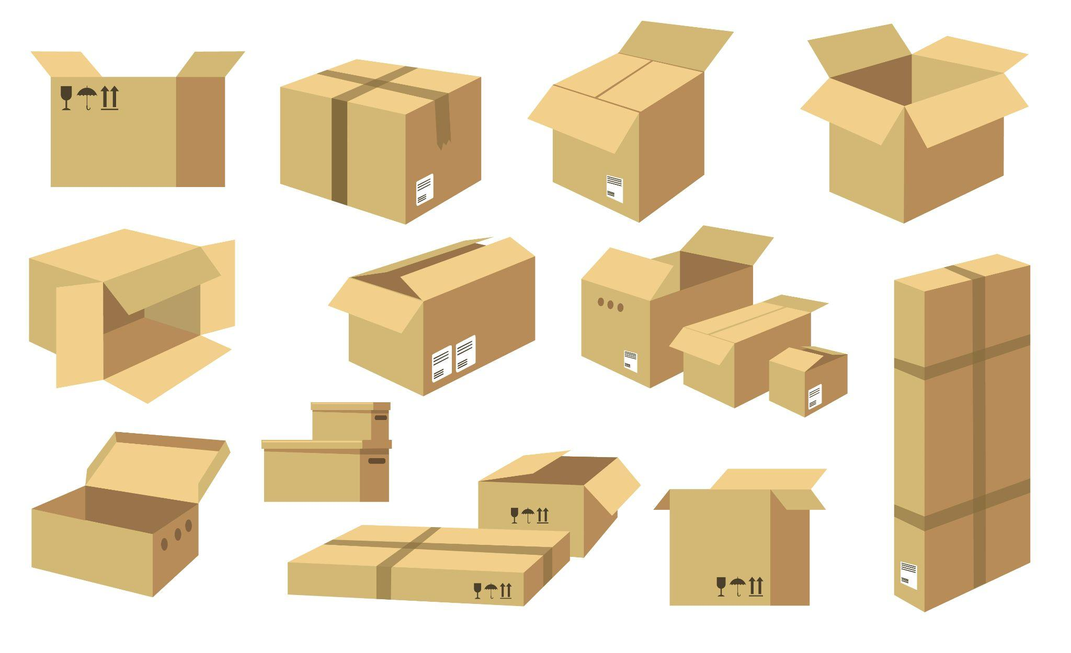
variables
Okay. Finally I have enough cartons to pack. I should pack all my things in these and seal them.
Image by pch.vector on https://www.freepik.com

Slide 14

Alright! I should pack these shoes and donate the boots to the donation centre at the university.
variables
Image by brgfx on https://www.freepik.com

Slide 15
variables
After two weeks, Siya is finally at her university hostel...

Slide 16

variables
That was a long, tiring journey. I should try to get some rest.
Images by upklyak on https://www.freepik.com

Slide 17

Okay, time to unpack. Now which of these boxes did I pack the boots in?
variables
Images by macrovector on https://www.freepik.com

Slide 18
variables
How will Siya be able to identify the box with the boots without opening the box?
?

Slide 19
Thank God I labelled the boxes while packing. I should take this box to the donation centre.
variables
BOOTS TO DONATE
Images by macrovector on https://www.freepik.com

Slide 20

variables
Mission Accomplished!
Images by macrovector on https://www.freepik.com

Slide 21
analogies
Shoe Box : Memory Location
Labelled Show Box : Variable
Label : Identifier
Notes:
Command – statements separated by newlines

Slide 22
identifiers
Name given to any building block – variable, function, class etc.
Should begin with a letter or an underscore
May consist of letters, underscores or digits
Other special characters are not allowed
Keywords cannot be used as identifiers
Case sensitive
Notes:
Command – statements separated by newlines

Slide 23
indentation, multi-line statements and comments
Indentation is used to indicate a block of code
All the lines in a block should have the same amount of indentation
Line continuation character - \
If a statement is enclosed within brackets, ‘\’ need not be used
‘ ‘, “ ”, “”” “”” – Triple quotes span the string across multiple lines
; - used to write multiple statements on one line
Comment - #, ‘’’ ‘’’
Notes:
Command – statements separated by newlines

Slide 24
variables
no = 10
institute = “SICSR”
amount = 100.22
a = b = c = 100
a,b,c = 100, 200, 300
print(a,b,c)
Notes:
Command – statements separated by newlines

Slide 25
Datatypes
type()
Number
Integer – 100, -100
Float – 10.2, 3e2, up to 15 decimal places
String
Sequence of characters
‘’, “”, “”” “””, ‘’’ ‘’’
Immutable – characters cannot be modified
List
Ordered Sequence of items of same or different datatypes
[1, 100.0, “SICSR”]
Mutable – elements can be modified
Tuple
Ordered Sequence of items of same or different datatypes
(1, 100.0, “SICSR”)
Immutable
Notes:
Command – statements separated by newlines

Slide 26
Datatypes
Set
Unordered Sequence of items of same or different datatypes
{1, 100.0, “SICSR”}
Unique values
Dictionary
Unordered sequence consisting of key-value pairs
{‘course’: ‘python’, 1:’sicsr’}
Type Conversion
- E.g. int(), str(), float(), set() etc.
- What is the output of:
>>>list(‘sicsr’)
>>>dict([[1,2], [3,4]])
Concatenation and Repetition
- +
- *
Notes:
Command – statements separated by newlines

